Slide 1

AD CLASSIFICATION
December 2022
PATTERN PROS:
Baluni, Sanyukta
Chilla, Madhulika
Gulati, Tavish
Patil, Soham
Sheth, Parth

Slide 2





PROJECT EXECUTION TEAM
Baluni,
Sanyukta
Gulati,
Tavish
Patil,
Soham
Sheth,
Parth
Chilla,
Madhulika
sbaluni@purdue.edu
tgulati@purdue.edu
patil124@purdue.edu
shethp@purdue.edu
mchilla@purdue.edu

Slide 3
AGENDA
Business Problem
Executive Summary
Scope & Methodology
Modelling
Conclusions & RECOMMENDATIONS
About client

Slide 4
ABOUT CRAIGSLIST
Craigslist is one of the most well-known websites for classified advertisements on the web. It is a hub or a platform with various interesting sections such as discussion forums, job postings, community service, items wanted, housing, and more.
~$1 billion
Annual Revenue
>700
Local Sites
80 million
Ads Posted Monthly
250.6 million
Visits Every Month
$3 billion
Valuation
70
Countries
60 million
Users
76%
Traffic from USA

Slide 5



EXECUTIVE SUMMARY
Lost Opportunity
Smote technique to handle imbalanced data
Precision and recall from confusion matrix
Categorizing posts from catchall sections to their respective categories
FINDINGS
OVERVIEW
Poor Customer Experience
Manual Labour & added cost of moderator
Expand the model to cater to more categories.
Conduct grid search or hyperparameter tuning to find the best parameters suited to our model.
Incorporate image processing for better predictions.
Improve the model to predict other subcategories by implementing external data in our model.
Reduced Mis-categorization
Reduced Manual Work
Better User Experience
Customer Retention
RECOMMENDATIONS
OUTCOMES
Notes:
2, 4, 6 : Outcomes: Stronger Vendor Relationships, Increase size of wallet of long-term vendors,
1, 3,5: Outcomes: Simpler Processes, Increase in Spend Visibility

Slide 6

BUSINESS PROBLEM & SCOPE

Slide 7

BUSINESS PROBLEM
Uncategorized posts or posts being put in vague categories. For eg, a category called ‘General’ exists in sales, which is a catchall for posts not being tagged in other categories – Hence, users are missing out on relevant posts.
~2%
Ads In General
belong to Cars*
~5%
Ads In General
belong to Beauty*
Manual Labour & added cost of moderator
Lost Opportunity
Poor Customer Experience

Slide 8
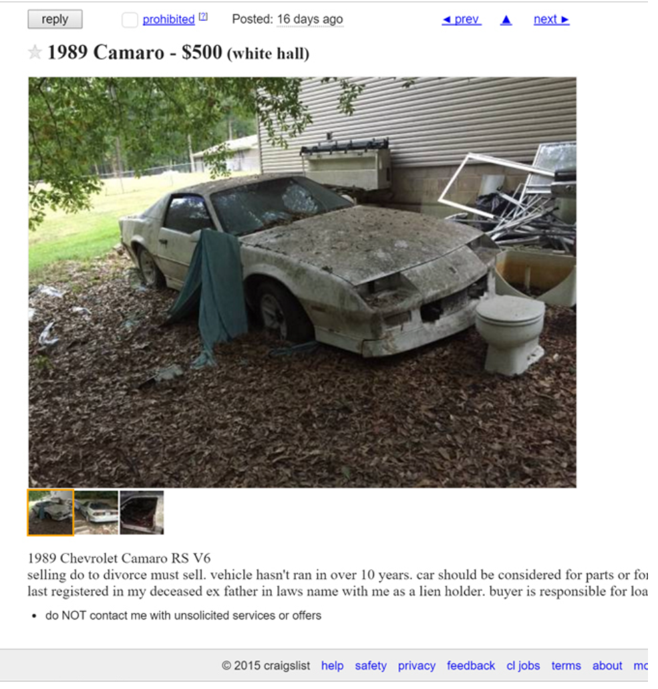
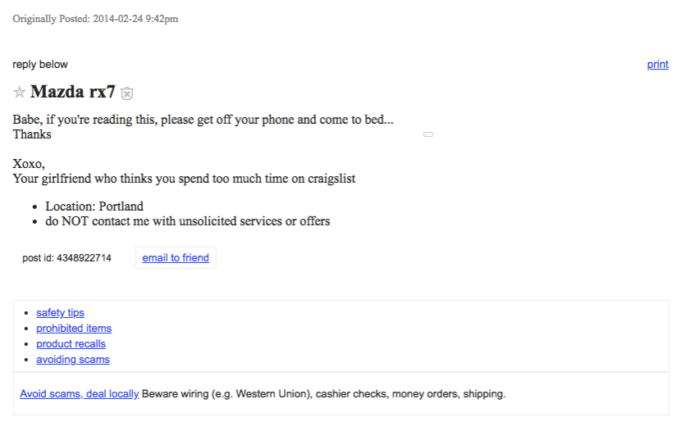
BUSINESS PROBLEM
QUALITY OF DATA!

Slide 9





How is misclassification handled right now?
Seller posts
an advertisement
User reports post if incorrect category
Development
team fix the issue
Advertisement
is updated
Identifying Problem after it reached our end user.

Slide 10
SCOPE
DATA PRE-PROCESSING AND TRAIN-TEST SPLIT
Cleaned data
Removed stop words
Tokenized
TF-IDF (After train-test split)
1
2
WEB DATA SCRAPING:
Total of 420 localities in USA, for which links were scrapped
For each of the 420 localities, we extracted the links for subcategories
3
MANUAL TAGGING
Tagged prediction data (1846 rows in ‘General’ subcategory into actual categories
Ran trained model on prediction dataset
MODELLING AND COMPARISON
Picked the model which had the best tradeoff between precision and recall
4

Slide 11

METHODOLOGY

Slide 12
METHODOLOGY
Scrape Data from Craigslist
Train-Test Split
Tokenization and Lemmatization
Data Labelling
Model Building
TF-IDF Vectorization

Slide 13
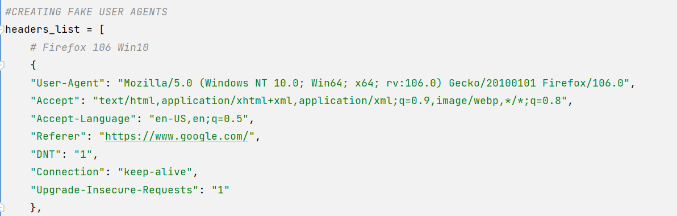
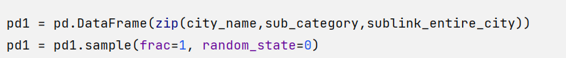
WEBSCRAPING LEARNINGS
USING FAKE AGENTS
SLEEP
RANDOMIZING LINKS READ

Slide 14
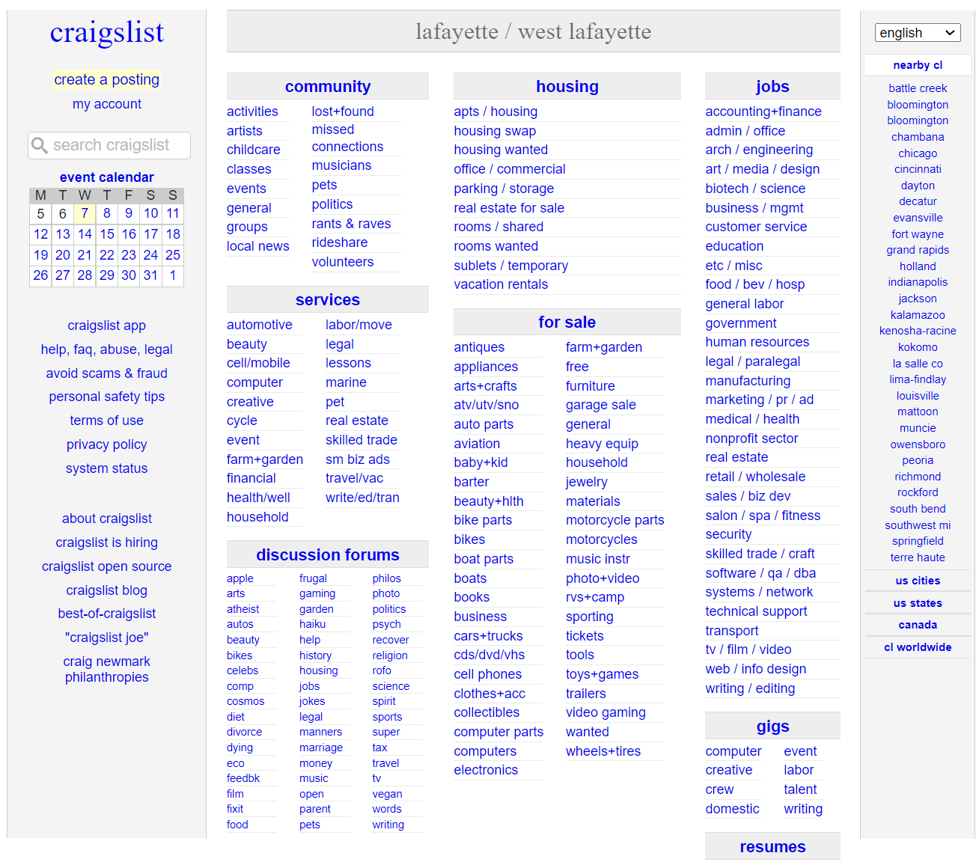
WHAT CATEGORY / SUBCATEGORY are we targeting?

Slide 15
WHAT CATEGORY / SUBCATEGORY are we targeting?

Slide 16
EXPLORATORY DATA ANALYSIS

Slide 17
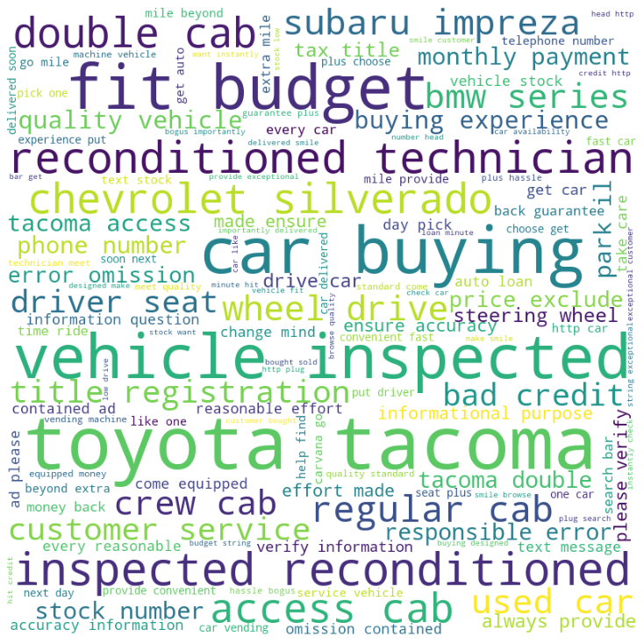
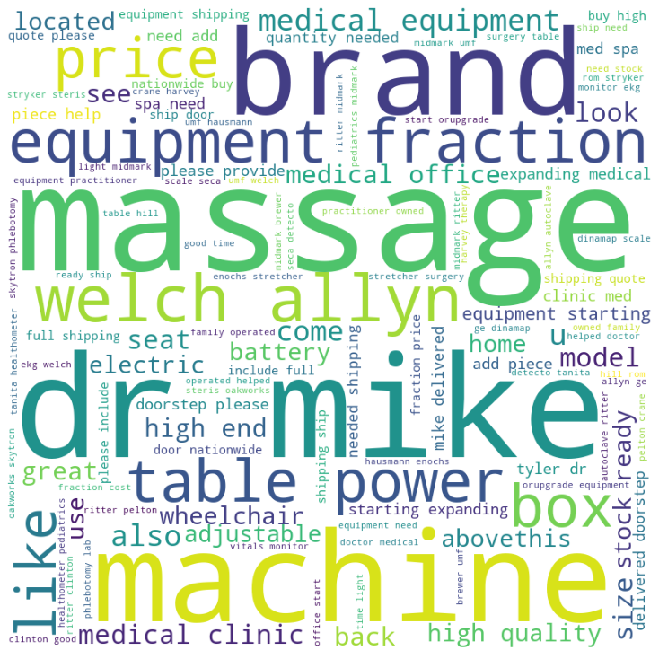
Word cloud for ‘cars+trucks’
EXPLORATORY DATA ANALYSIS
Word cloud for ‘beauty+hlth’

Slide 18

ANALYSIS

Slide 19
MODELS USED
95.12%
95.10%
Linear SVC (Multi_class = ‘OVR’)
93.07%
92.50%
Logistic Regression
(Multi_class=‘multinomial’)
Linear SVC
91.76%
Random Forest
Gradient Boosting

Slide 20
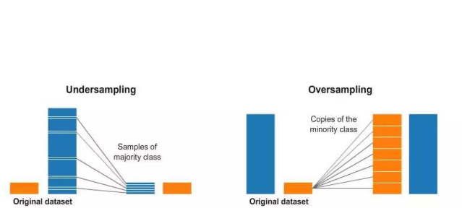
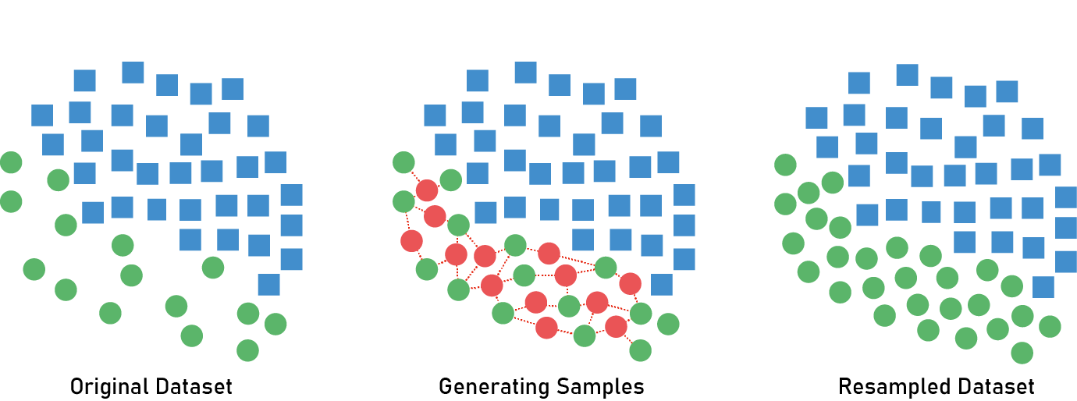
DEALING WITH IMBALANCED DATA
UNDERSAMPLING AND OVERSAMPLING
SMOT (SYNTHETIC MINORITY OVERSAMPLING TECHNIQUE)

Slide 21
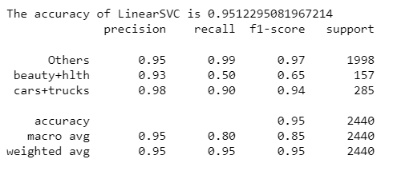
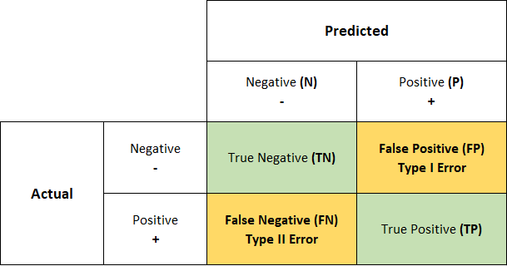
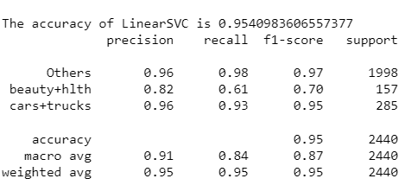
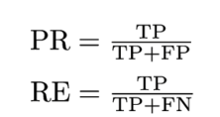
RESULTS FROM BEST MODEL (WITH AND WITHOUT OVERSAMPLING)
BEFORE SMOT
AFTER SMOT

Slide 22
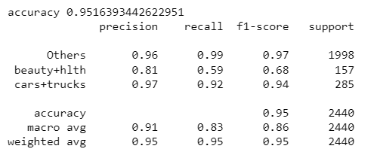
RESULTS ON PREDICTION DATASET

Slide 23
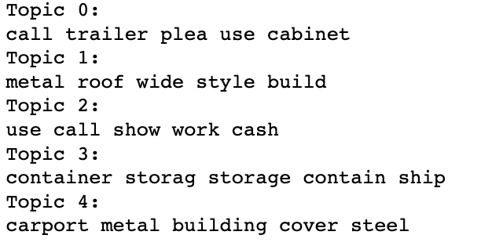
TOPIC MODELING - LDA
Topic modeling was done on general category data. After categorizing the general category data through classification into ‘cars+trucks’ , ‘beauty+hlth’ and others, we decided to perform topic modeling on this others sub-category to find topic distribution of advertisements.

Slide 24
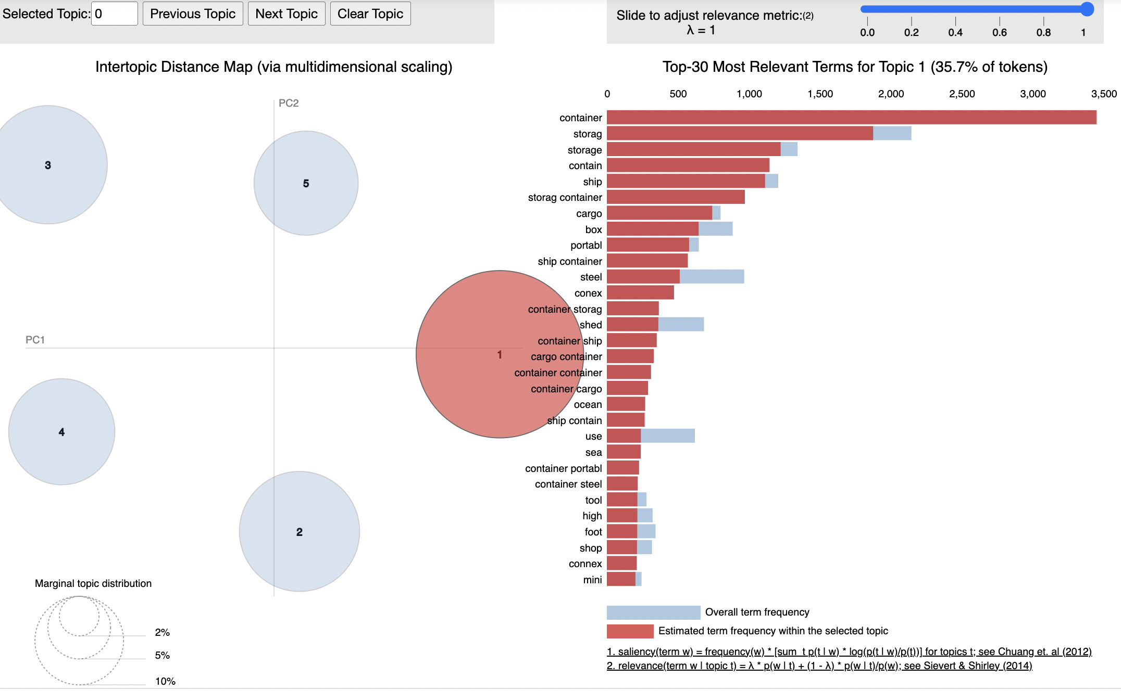
TOPIC MODELING - LDA
A good topic model has fairly big, non-overlapping bubbles scattered throughout the chart instead of being clustered in one quadrant
Through topic modeling we realized that topic 1 talk about shipping containers, storage containers.
The intertopic distance map is a visualization of the topics in a two-dimensional space . The area of these topic circles is proportional to the amount of words that belong to each topic across the dictionary.

Slide 25




LIMITATIONS
DATA
Presence of imbalanced data
RESTRICTED ACCESS TO WEBSITE
Difficulties to extract more data
IMAGE
Ads with only images could not be accounted
DESCRIPTION
Valid ads without a body text were ignored.

Slide 26

CONCLUSION AND RECOMMENDATION

Slide 27
CONCLUSION
Attained model accuracy of 95% using linear SVC
Correctly classified ~6% ads in general category related to ‘cars + trucks’ and ‘beauty + health’ categories.
Since, we cater to our customers, they don’t switch to other platforms to post their ads.
Our model saves the manual work of tagging the ads by craigslist

Slide 28




RECOMMENDATIONS
Expand the model to cater to more categories.
Incorporate image processing and pricing for better predictions.
Conduct grid search or hyperparameter tuning to find the best parameters suited to our model. Can also ensemble best models.
Improve the model to predict other subcategories by implementing external data in our model.

Slide 29

THANK YOU!

